Slide 1
DOLLAR TRACKER
Fall 2023

Slide 2



NEEDS AND CUSTOMER SEGMENTS
Emerging Professionals
Entrepreneur and Freelancer
Parents and Families
Manual tracking
Struggle with financial independence
Juggling multiple accounts
Complex income streams
Balancing multiple expenses for a family of 3+
Time consuming task
Fall 2023

Slide 3
PROPOSED SOLUTIONS
Automated Expense Tracking
Forecasting and Budgeting Tools
Budgeting and Spending Limit
Family Expense Pooling
Student Loan Tracking
Education Fund Tracker
Tax Deduction Insights
Investment Opportunities
Fall 2023

Slide 4
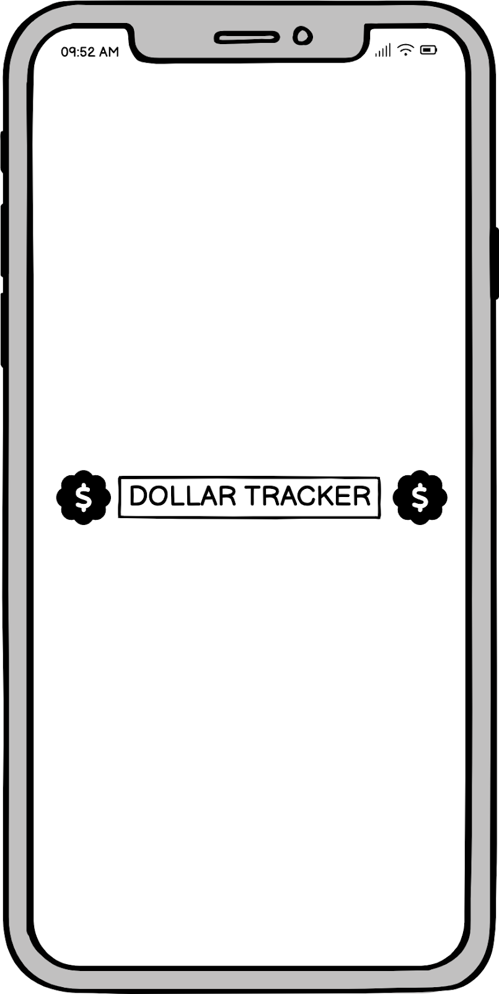
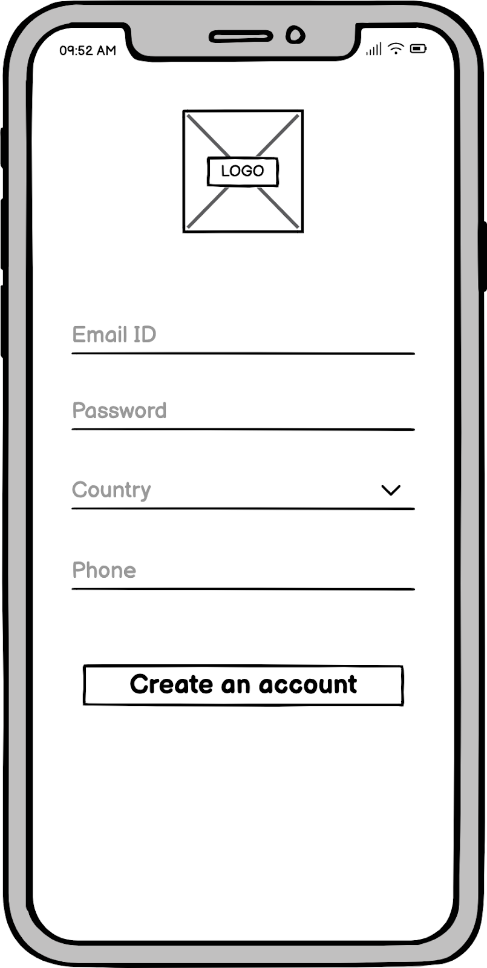
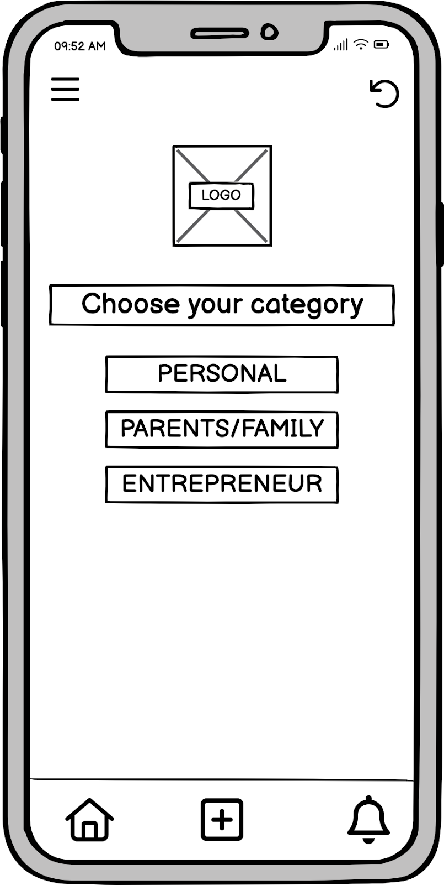
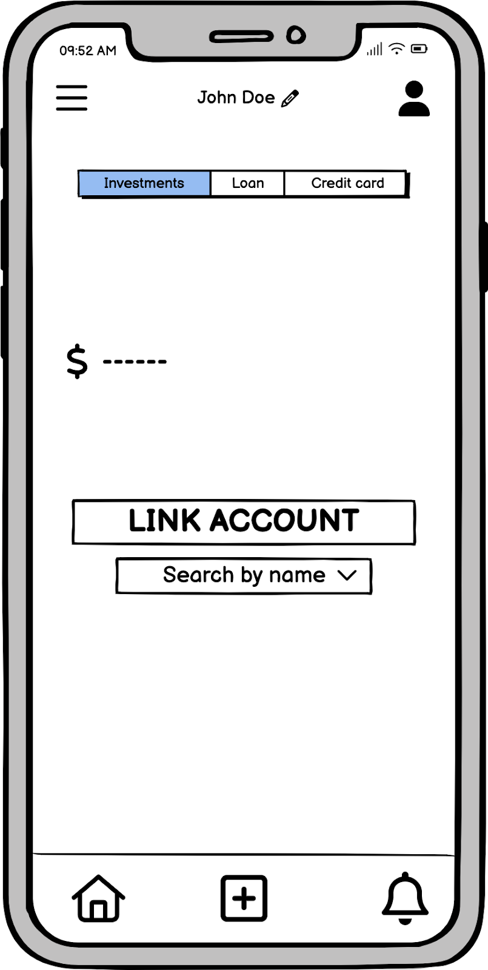

STORYBOARD
John logs into Dollar Tracker, selects his profile and links his bank account.
Fall 2023

Slide 5
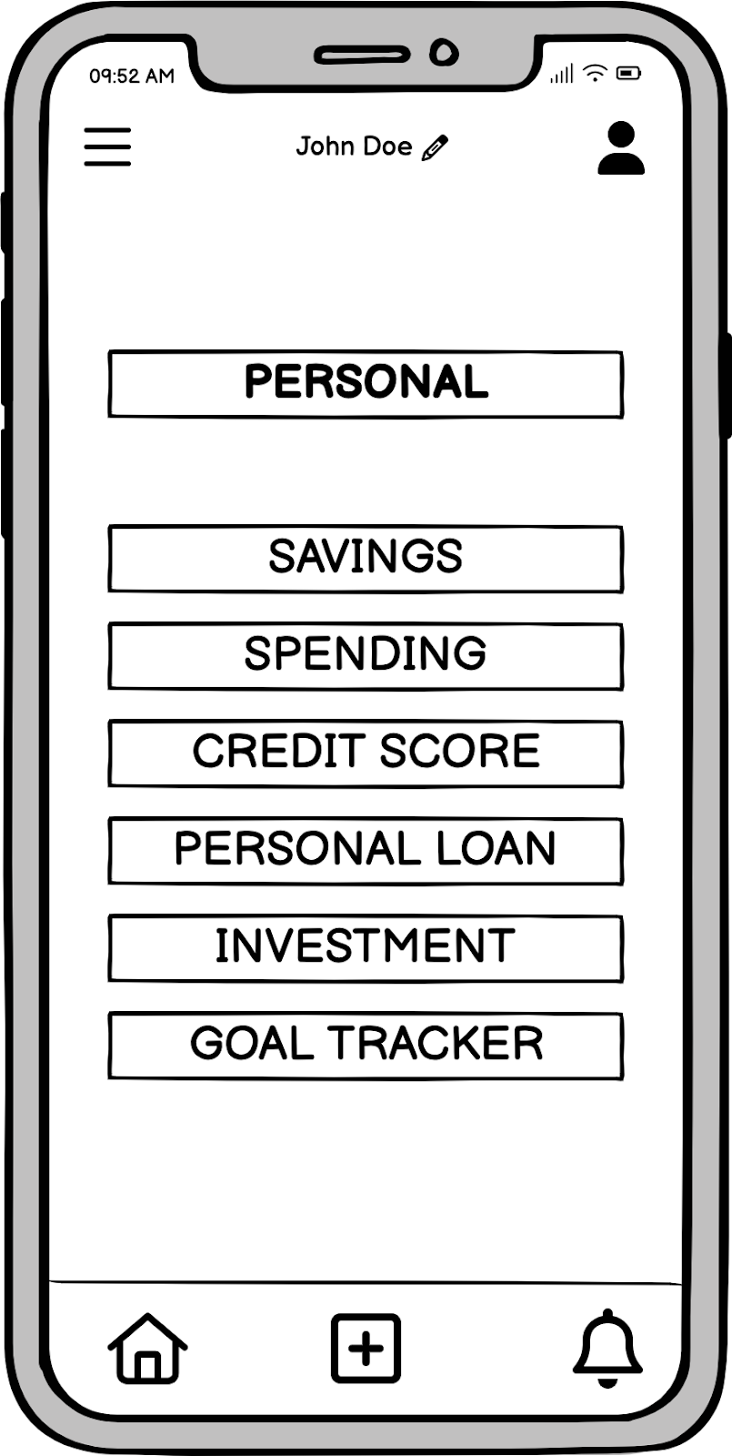
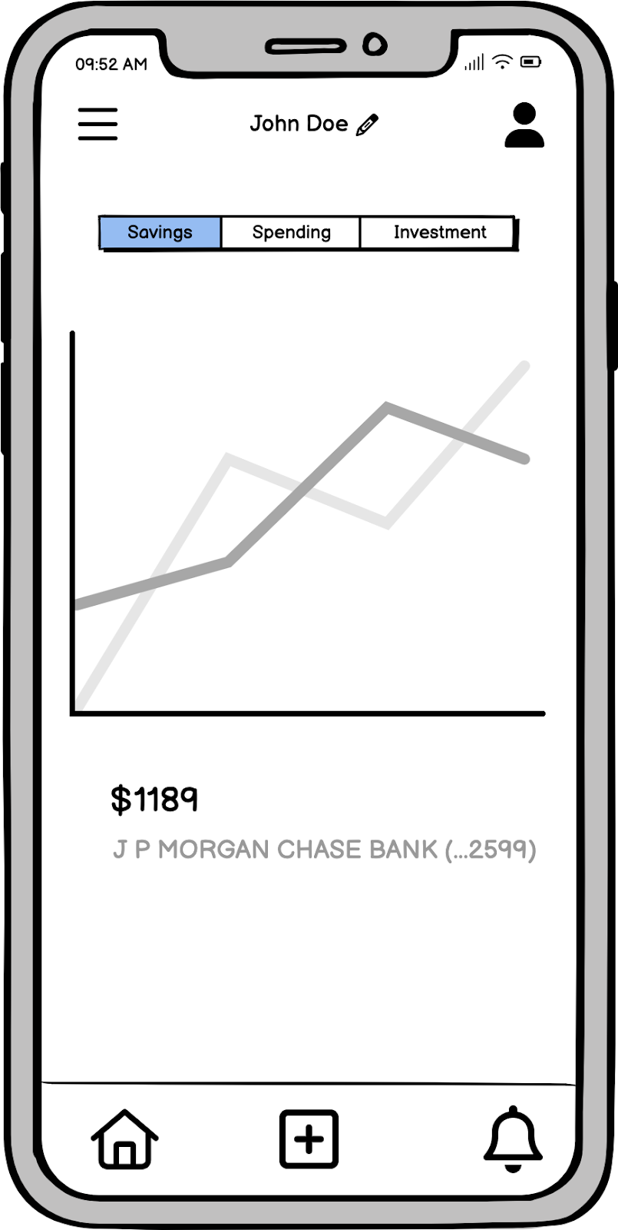
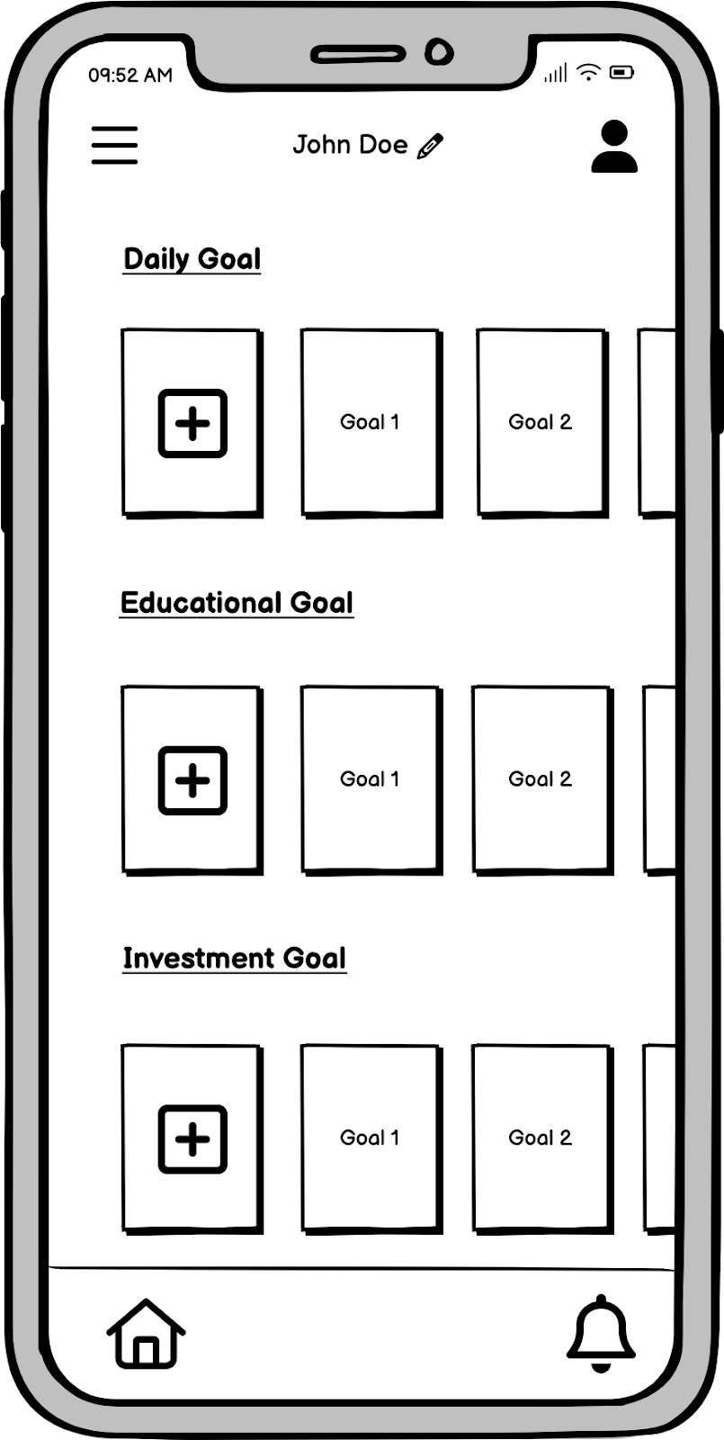
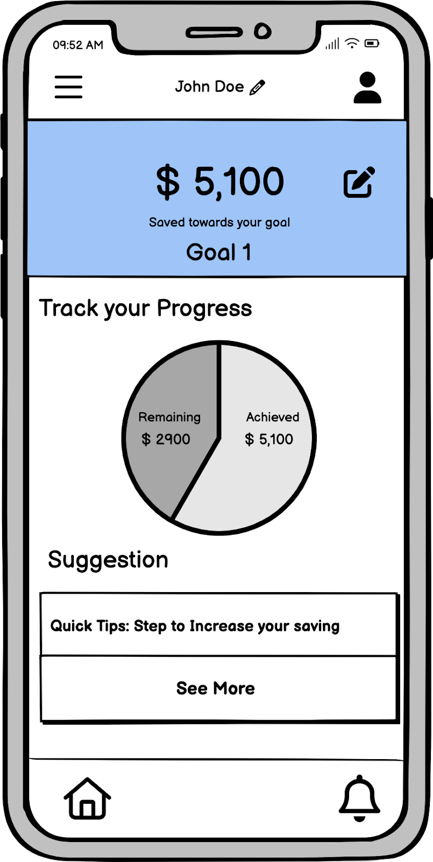
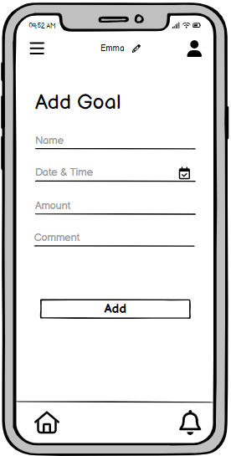
STORYBOARD
John checks his savings summary, tracks multiple goals under one platform and checks his goal summary at that moment.
Fall 2023

Slide 6


PRODUCT ROADMAP
QUARTER 3
Optimizing Performance
Multiple-Factor Verification
Data Protection and Restoration
QUARTER 4
Dashboard for Advanced Analytics
Integration of User Feedback
Chat Support for App
QUARTER 1
Onboarding Optimization UI Modernization
Quick Access Features
QUARTER 2
Budgeting Module
Third-Party Integration
Improvement of Expense Categories
Fall 2023

Slide 7
PRODUCT FEATURES
Collaborative Expense Sharing
Setting Financial Goals
Customizable Spending Categories
Automated Transaction Import
College Fund Tracking
Fall 2023

Slide 8
MVP FEATURES - LAUNCH
Real-time Expense Tracking
User Onboarding and Tutorials
Education Fund
Tracker
Basic Expense Analytics
Future Expense Tracking
Fall 2023

Slide 9
KEY METRICS
North Star metric- Monthly Net Savings
Retention
Rate
Customer Acquisition
Cost
Annual Revenue Per User
Daily Active Users
Monthly Active Users
Net Promoter Score
Fall 2023

Slide 10


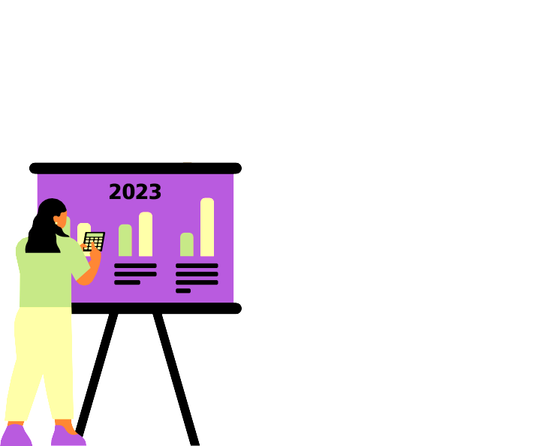


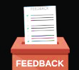
OPERATIONAL NEEDS
Beta-testing
Market research App Development
Pre-launch Analysis
Fall 2023

Slide 11
PROJECTED COSTS
Estimated Boston Market Potential = $3.36 million per year
Labor Cost: $339,200
IT Equipment Cost: $30,000
Software Licensing Cost: $3,503
Infrastructure + Maintenance Cost: $6,500
Miscellaneous Cost: $7,000
Total Projected Cost = $386,203
Fall 2023

Slide 12


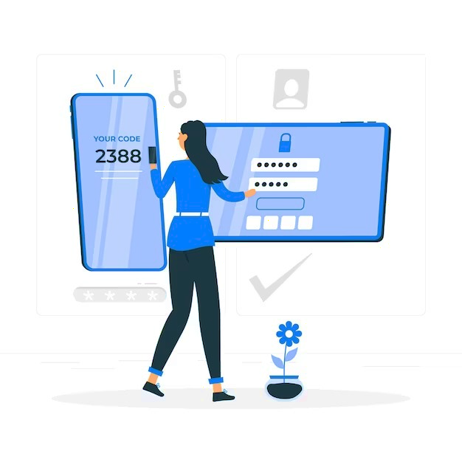

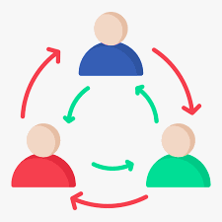



RISKS
Legal and Compliance Risk
Privacy Concerns
In-depth Research
Two-factor Authentication
Interdependencies with Third-Party Services
Monetization
Strategy
Develop Contingency Plans
Periodic User Feedback
Fall 2023

